Slide 1
ECONOMICS STD-9
CHAPTER-1
THE STORY OF VILLAGE PALAMPUR
THE VILLAGE OF PALAMPUR/ ECONOMICS/Mrs Sujatha-/SOCIAL SCIENCE/SNS ACADEMY
6/23/202

Slide 2
In your region, talk to two labourers. Choose either from farm labourers or labourers working at construction sights. What wages do they get? Are they paid in cash or kind? Do they get work regularly? Are they in debt? Prepare a report.

Slide 3
AIM
6/23/2020
THE VILLAGE OF PALAMPUR/ ECONOMICS/Mrs Sujatha-/SOCIAL SCIENCE/SNS ACADEMY

Slide 4
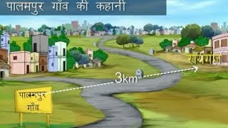
Village of Palampur
Near UttarPradesh
3 kms from Raiganj 450 families
80% - uppercaste families
1/3rd – lower caste
All weather roads electricity
Different means
of transport from
bullock carts to trucks
Primary health care centre Multicropping
6/23/2020
THE VILLAGE OF PALAMPUR/ ECONOMICS/Mrs Sujatha-/SOCIAL SCIENCE/SNS ACADEMY

Slide 5
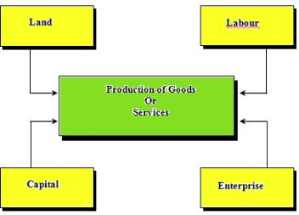
FACTORS OF PRODUCTION
Land- Major factor
Fixed
Cannot be expanded
Skilled labour
2) Labour –
Manual labour
3) Physical capital Fixed capital
Working capital
4) Human Capital- Knowledge and enterprise to
combine all the above three.
6/23/2020
THE VILLAGE OF PALAMPUR/ ECONOMICS/Mrs Sujatha-/SOCIAL SCIENCE/SNS ACADEMY

Slide 6
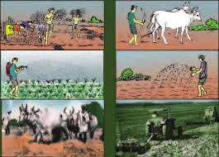
Farming in Palampur
Land
75%
Farming in own land Farming in others land
Crops:
Khariff crop Rabi crop
Jowar, Bajra wheat
Sugarcane is grown once in a year
Irrigation – From Persian wheels to Tubewells.
6/23/2020
THE VILLAGE OF PALAMPUR/ ECONOMICS/Mrs Sujatha-/SOCIAL SCIENCE/SNS ACADEMY

Slide 7
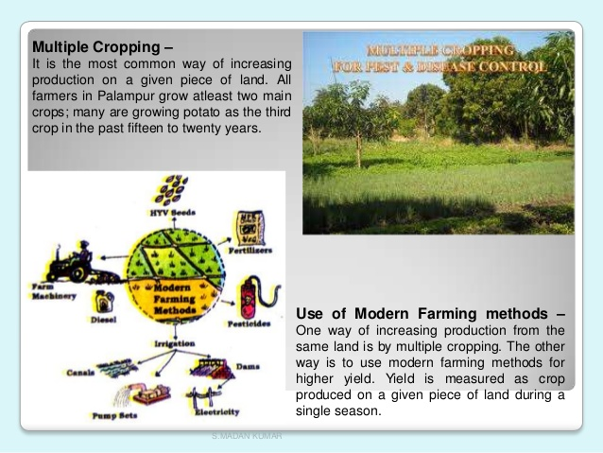
Multiple cropping
6/23/2020
THE VILLAGE OF PALAMPUR/ ECONOMICS/Mrs Sujatha-/SOCIAL SCIENCE/SNS ACADEMY

Slide 8
MODERN FARMING METHODS
6/23/2020
THE VILLAGE OF PALAMPUR/ ECONOMICS/Mrs Sujatha-/SOCIAL SCIENCE/SNS ACADEMY

Slide 9
RESULTS OF GREEN REVOLUTION
Till 1960’S
Traditional seeds
Less water
Cowdung and natural manure as fertilizer
After 1960
Green revolution
HYV seeds
2.5 times increase in production
Two challenges of HYV seeds:
Soil fertility in trouble.
Increase in underground
water usage. Takes time to
rebuild
6/23/2020
THE VILLAGE OF PALAMPUR/ ECONOMICS/Mrs Sujatha-/SOCIAL SCIENCE/SNS ACADEMY

Slide 10
NON FARMING ACTIVITIES
DAIRY
SMALL SCALE INDUSTRIES
SHOPKEEPERS
TRANSPORT
6/23/2020
THE VILLAGE OF PALAMPUR/ ECONOMICS/Mrs Sujatha-/SOCIAL SCIENCE/SNS ACADEMY

Slide 11
NON FARMING ACTIVITIES IN PALAMPUR
DAIRY
SMALL SCALE MANUFACTURING
People feed buffalos with grass, jowar, bajra.
Milk is sold at raiganj- large village.
Collection cum chilling centres at Shahpur.
They use simple production methods.
They carry out mainly at home or in the fields.
They rarely hire labourers.
6/23/2020
THE VILLAGE OF PALAMPUR/ ECONOMICS/Mrs Sujatha-/SOCIAL SCIENCE/SNS ACADEMY

Slide 12
THE SHOPKEEPERS & TRANSPORT
Few families close to the bus stand use a part of their space to open small shops.
Items of sale:
Rice, wheat, sugar, tea, oil…………
Means of transport include:
Rikshawwalah,, tongawallah, jeep, tractor, bogey……
They ferry people from one place to another and in return get paid for it.
6/23/2020
THE VILLAGE OF PALAMPUR/ ECONOMICS/Mrs Sujatha-/SOCIAL SCIENCE/SNS ACADEMY

Slide 13
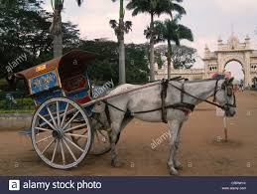
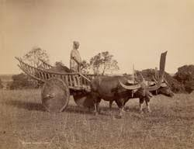
Tongas and Bogey
THE VILLAGE OF PALAMPUR/ ECONOMICS/Mrs Sujatha-/SOCIAL SCIENCE/SNS ACADEMY
6/23/2020

Slide 14
Questions:
1)Is Palampur a developed village?
Explain by giving five arguments.
2)What can be done to start more and more non-farming activities in villages?
THE VILLAGE OF PALAMPUR/ ECONOMICS/Mrs Sujatha-/SOCIAL SCIENCE/SNS ACADEMY

Slide 15
REFERENCES :
1)Etienne, gilbert. 1985, Rural development in Asia: Meetings with peasants, Sage publications New Delhi.
2) http:economistimes.indiatimes.com/news/policy/government-hikes-minimumwage-for-agriculture-labourer/article show/57408252.cms
Thank you.

